Slide 2
Digital Forensics Lecture-21
By- Dr.subhranil Das
Assistant Professor
School of computer Science

Slide 3

Log Files
Attribution is a major goal and log files can record which account was used to access a system at a given time.
User accounts allow two forms of access to computers: interactive login and access to shared resources.
Both forms of access can significantly expand the pool of suspects in an investigation.
If illegal materials are found on a computer, individuals with legitimate access to the computer are the obvious suspects.
If secret information is stolen from a computer system or a computer is used to commit a crime, it is possible that someone gained unauthorized access to the computer

Slide 4
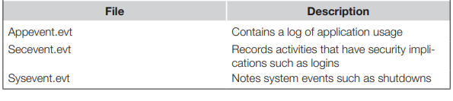
Roots of the file
Modern Windows operating systems store log files in the “%systemroot%\ system32\config\” folder (most commonly “c:\winnt\system32\config\”).

Slide 5
System Log Files
System log files can contain the information about user accounts that were used to commit a crime and can show that a user account might have been stolen.
The Application and System event logs also contain information about user activities on a system such as burning a CD, inserting a removable USB mass storage device, and backdating the system clock as shown here.

Slide 6
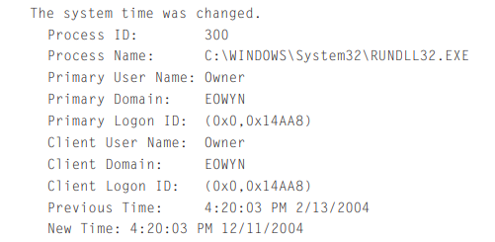
System Log Information

Slide 7
Registry
Windows systems use the Registry to store system configuration and usage details in what are called “keys.”
Registry files (a.k.a. hives) on Windows 95 and 98 systems are located in the Windows installation folder and are named “system.dat” and “user.dat.”
The Registry on Windows NT/2000/XP is comprised of several hive files located in “%systemroot%\system32\config” and a hive file named “ntuser.dat” for each user account.
The values in some Registry keys are stored in hexadecimal format but can be converted to ASCII and saved to a text file using the “Save Subtree As” File menu option of regedt32.
For instance, the following Registry key shows the names of files that were played recently using Windows MediaPlayer ( is substituted for the security identifier of the user on the system)

Slide 8
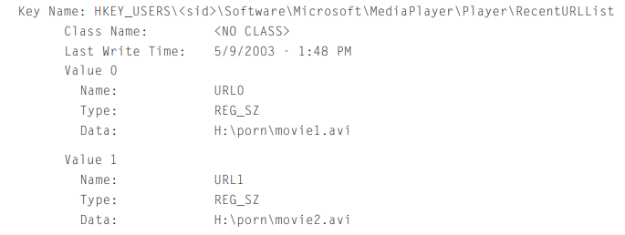
Key Name

Slide 9
Internet Traces
Accessing the Internet leaves a wide variety of information on a computer including Web sites, contents viewed, and newsgroups accessed.
For instance, some Windows systems maintain a record of accounts that are used to connect to the Internet.
Additionally, some Windows systems maintain a log of when the modem was used (e.g., ModemLog.txt) and some Internet dial-up services maintain

Slide 10
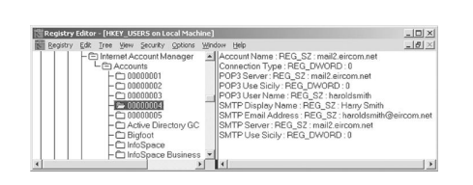
Internet Account Manager

Slide 11
Web Browsing
When an individual first views a Web page, the browser caches the page and associated elements such as images on disk—the creation and modification times are the same time as the page was viewed.
When the same site is accessed in the future, the cached file is accessed.
The number of times that a given page was visited is recorded in some Web browser history databases.
Firefox 3 maintains a database of Web sites visited in a SQLite file named “Places.sqlite,” and earlier versions of Firefox store this information in a database named “history.dat.”
Entries that have been marked as deleted by Firefox can be recovered, and additional deleted items may be recovered from other areas on a hard drive.
Internet Explorer maintains similar information in files named “index.dat.” These databases can contain a wealth of information including sites accessed and search engine details.

Slide 12
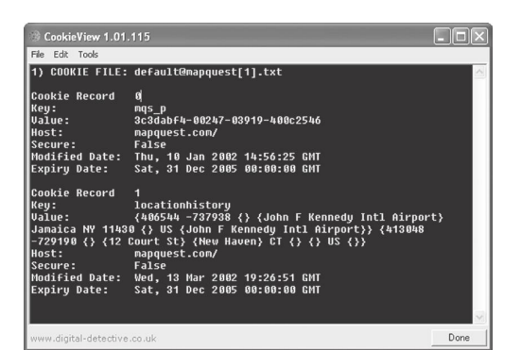
A cookie created by MS Internet Explorer

Slide 13
E-Mail
E-mail clients often contain messages that have been sent from and received at a given computer.
While Netscape and Eudora store e-mail in plain text files, Microsoft Outlook, Outlook Express, IBM Lotus Notes, Novell GroupWise, and America Online (AOL) use proprietary formats that require special tools to read.
Even when e-mail is stored in a non-proprietary format, it is necessary to decode MIME-encoded message attachments.
FTK can interpret a variety of proprietary formats, including Outlook. EnCase can also interpret some of these proprie formats using the View File Structure feature.
Another approach to viewing proprietary formats, such as AOL, is to restore them to a disk and view them via the AOL client.

Slide 14
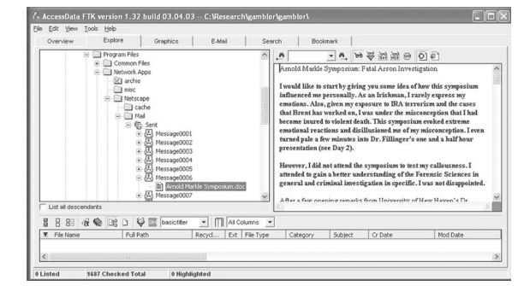
FTK showing Word document as e-mail attachments

Slide 15
Next Lecture
Digital Evidences in UNIX System
.

